Slide 1
Code Dojo – Fruit Shop
22/04/2015

Slide 2

Code Dojo Some Principles
Communicate
with your partner, be a pair, with the group
Code is design
No design talk without code, no code without talking
Slow down
No due date, no delivery, no tricks
Learning
Open-minded, from others
Challenge yourself
don’t be reluctant to try something new
Notes:
29/04/2013

Slide 3



Some tools (optionals)
JetBrains Resharper (R#)
Productivity tool
Third hand of the developer
Must have for safe refactoring
Ncrunch
Continuous testing tool
Increase speed and feedback of unit testing
TDD without knowing
nFluent
Better assertions
Gorgeous error messages

Slide 4
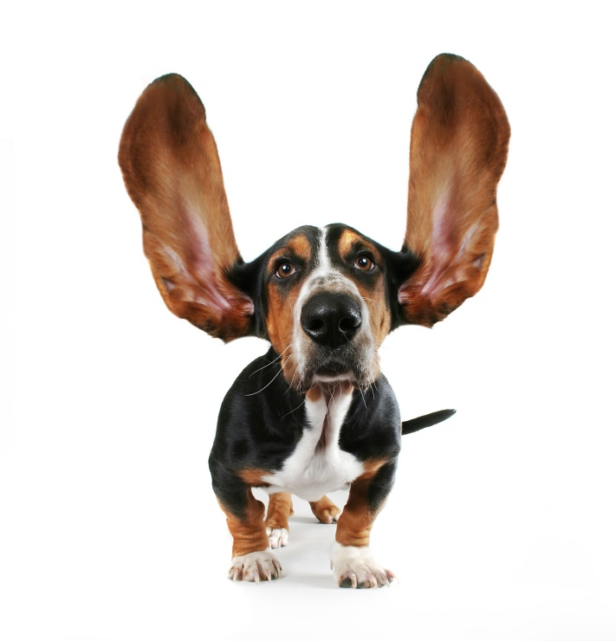

Some tips
Talk
Baby steps
Red Green Refactor
Talk
Switch pilot as much as possible
(Listen)

Slide 5
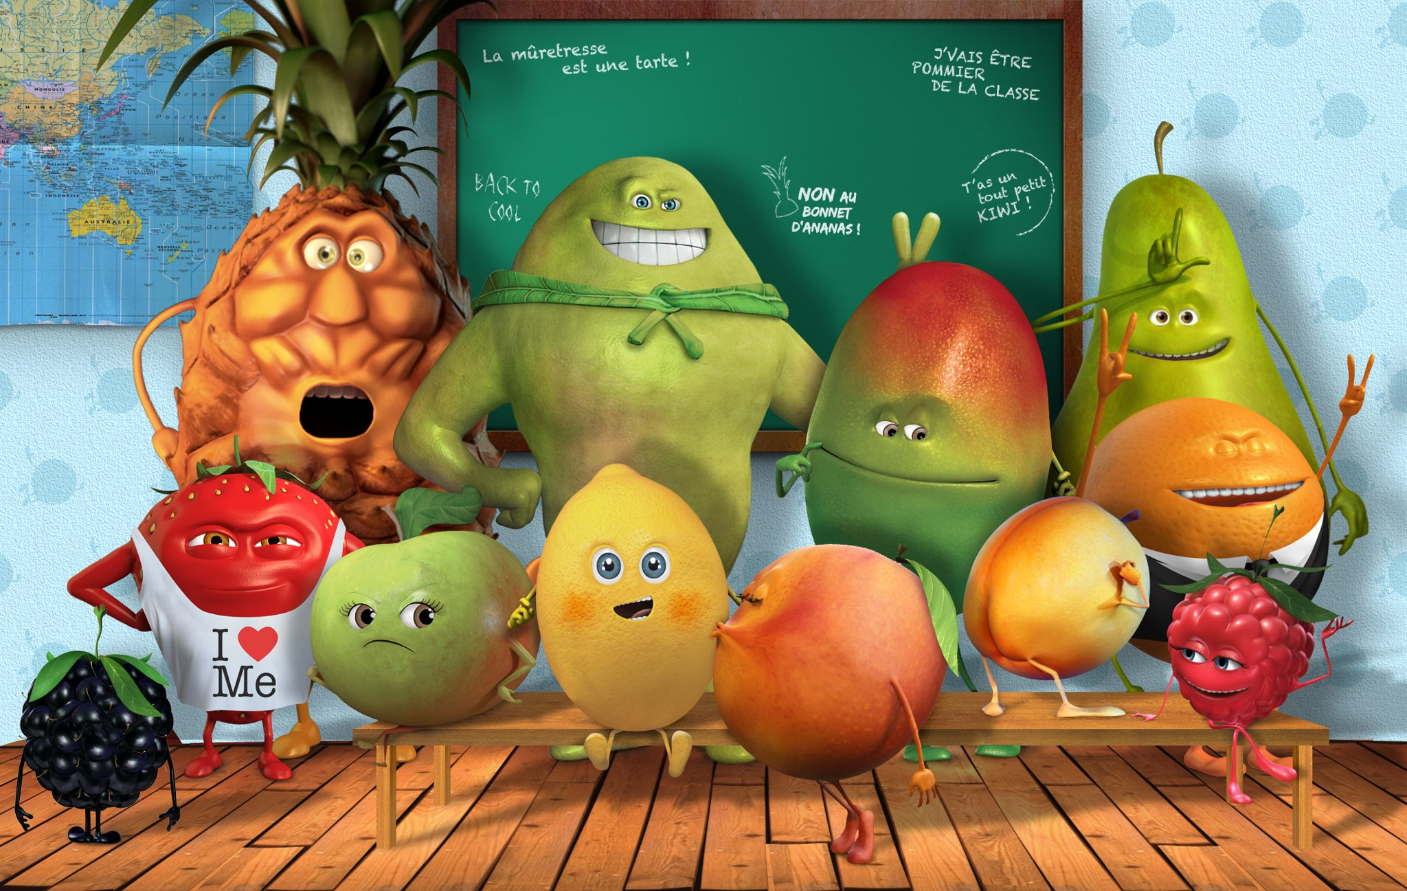
Fruit shop

Slide 6

Iteration 0
10’
Pair with another dev
Take a pc
You’re free to use (try to use) any languages
Setup a blank project
Relax
And prepare to become the dev team of the Fruit shop

Slide 7
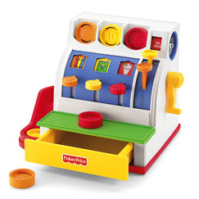
Iteration 1
10’
Goal : Implement a cashier machine
3 products
Apples 1 €, Bananas 1,5€, Cherries 0,75€
1 product is entered at a time, when entered display total price in cents
Tests
> Apples-> 100
> Cherries-> 175
> Cherries-> 250
Tests 2
> Cherries- -> 75
> Apples- -> 175
> Cherries- -> 250
> Bananas -> 400
> Apples- -> 500

Slide 8

Iteration 2
10’
Goal : Manage offers
For 2 pack of cherries, get a 20 cents discount
Tests
> Apples -> 100
> Cherries -> 175
> Cherries -> 230
Tests 2
> Cherries -> 75
> Apples -> 175
> Cherries -> 230
> Bananas -> 380
> Cherries -> 455
> Cherries -> 510
> Apples -> 610

Slide 9

Iteration 3
10’
Goal : Support CSV format
Products are delimited by a comma
Keep existing offers and discounts
Tests
> Apples, Cherries, Bananas -> 325
> Apples -> 425

Slide 10

Iteration 3

Slide 11
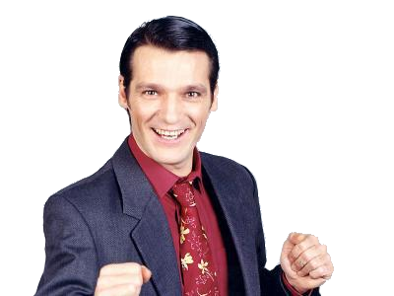
Iteration 3’
?
X
CSV is abandoned but
Deadline is unchanged !
Back to “One product per line”
Cherries discount is now 30 cents
New offer : for one Banana pack, the second is free
Tests 2
> Cherries -> 75
> Apples -> 175
> Cherries -> 220
> Bananas -> 370
> Apples -> 470
> Bananas -> 470
> Cherries -> 545
Tests
> Cherries -> 75
> Cherries -> 120
> Bananas -> 270
> Bananas -> 270

Slide 12


Iteration 4
10’
Goal : Localization
We must support “Pommes” and “Mele” for “Apples”
Cherries discount is back to 20 cents
Tests
> Cherries -> 75
> Pommes -> 175
> Cherries -> 230
> Bananas -> 380
> Bananas -> 380
Tests 2
> Cherries -> 75
> Pommes -> 175
> Cherries -> 230
> Bananas -> 380
> Apples -> 480
> Mele -> 580

Slide 13
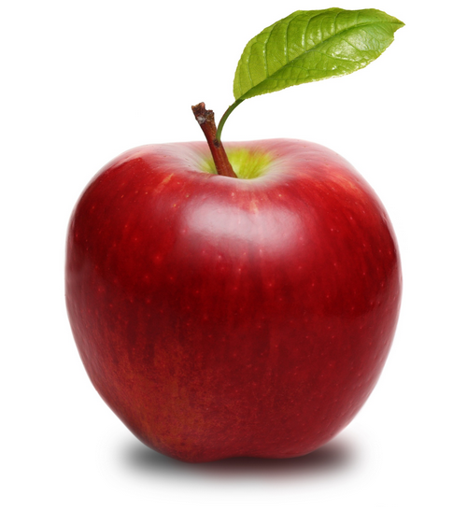
Iteration 5
10’
Goal : Special offers per localization
3 packs of “Pommes” cost 2€
2 packs of “Mele” cost 1,5€
Tests
> Mele -> 100
> Pommes -> 200
> Pommes -> 300
> Apples -> 400
> Pommes -> 400
> Mele -> 450
> Cherries -> 525
> Cherries -> 580

Slide 14
Iteration 5

Slide 15
Iteration 5’
?
New Hardware : Redeploy ASAP
… Deadline is unchanged
CSV format is mandatory
3 packs of “Pommes” cost 2€
2 packs of “Mele” cost 1€
Tests 2
> Cherries, Pommes-> 175
> Cherries -> 230
> Pommes, Apples, Bananas -> 580
> Apples, Pommes -> 680
> Mele -> 780
> Apples -> 880
Tests
> Mele, Pommes, Pommes, Apples, Pommes, Mele, Cherries, Cherries
, Bananas -> 680

Slide 16

Iteration 6
10’
Goal : Bugfixing + Hot deal
4 packs of all kind of “Apples” 1€ discount
(Mele, Pommes & Apples)
5 packs of fruits 2€ discount
Tests
> Mele, Pommes, Pommes, Mele -> 200
> Bananas -> 150
> Mele, Pommes, Pommes, Apples, Mele -> 150
Tests 2
> Mele, Pommes, Apples, Pommes, Mele -> 100
> Bananas -> 250

Slide 17
Conclusion
Have you used a source control software ?
Have you coded some unitests ? From which iteration ?
Have you coded and maintained Acceptance tests ?
What happened to the CSV code when reverted ?
Do you think your code is clean ?
Does the software match the business need ?

